Slide 1
Parachute Industry Association (PIA)
14 - 17 August 2024 Spokane, WA.
Prepared by Arnold Aaron

Slide 2
Aviation Planning Org Structure
Director – Kent Ennis
Deputy Director – Amanda Bangs
Division Chief – Troy Thomas
Deputy Division Chief – Kathiria (Kathy) Robinson
Branch Chief (Life Support) – Arnold Aaron
Supervisor (Life Support) – Anita Burden
Materiel Planner (Army & Marines) – Shaunta Walton
Material Planner (Air Force & Navy) Darell Hodnett
Source: Director’s Office DLA Slide Template As of August 26, 2020

Slide 3
FY 24/25 Goals
Improve MA to 80 percent
Increase holistic communication and knowledge
Improve customer collaboration
Encourage/Improve forecasting
Decrease Lead-time
Seek more sources of supply

Slide 4
Parachute Supply Availability (SA)

Slide 5
Top Ten NIIN Effecting Supply Availability
NIIN | FSC | NOMENCLATURE | Orders Received | Backorders Established | Supply Availability | ADF | ADQ | SOH | AAC | AMC | AMSC | RMC
010676838 | 1670 | EXTENSION,EXTRACTIO | 656 | 648 | 1.2% | 305 | 11,854 | 0 | D | 1 | G | R
004864891 | 1670 | HARNESS,PERSONNEL | 419 | 392 | 6.4% | 193 | 628 | 0 | D | 1 | G | R
013239900 | 1670 | BAND,RUBBER,PARACH | 475 | 257 | 45.9% | 313 | 13,094 | 0 | D | 1 | G | R
003695444 | 1670 | HARNESS,PERSONNEL | 252 | 248 | 1.6% | 146 | 1,366 | 0 | D | 1 | T | R
016829757 | 1670 | HARNESS,PERSONNEL | 156 | 140 | 10.3% | 149 | 329 | 0 | Z | 3 | R | N
992381934 | 1670 | HARNESS,PERSONNEL | 134 | 134 | 0.0% | 95 | 209 | 0 | Z | 3 | C | N
007533928 | 1670 | PAD,ENERGY DISSIPAT | 406 | 129 | 68.2% | 512 | 5,149 | 320 | D | 1 | G | R
005680323 | 1670 | BAND,RUBBER,PARACH | 533 | 101 | 81.1% | 366 | 14,763 | 243,800 | D | 1 | G | R
015391339 | 1670 | BAND,RUBBER,PARACH | 85 | 84 | 1.2% | 38 | 3,064 | 0 | D | 1 | G | R
998993020 | 1670 | PARACHUTE,PERSONNE | 98 | 83 | 15.3% | 46 | 91 | 24 | D | 3 | C | R

Slide 6
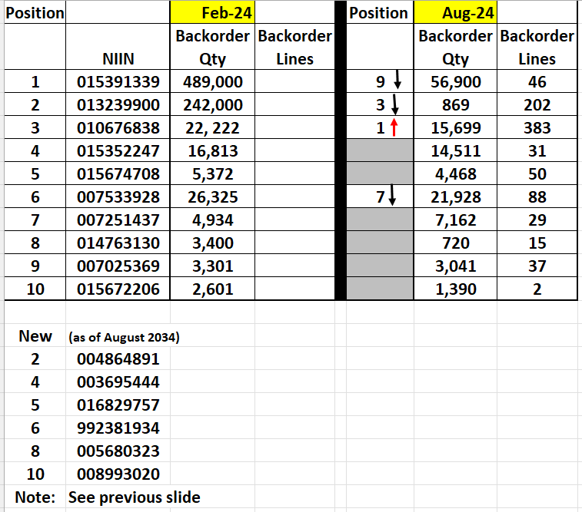
Top NIIN’s Position by BOE (February –August 2024)
As of 9 August 2024

Slide 7
NIIN’s With No Source of Supply
As of 9 August 2024

Slide 8
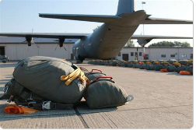
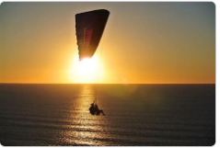
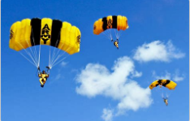
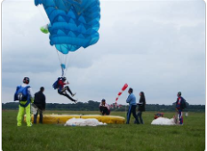
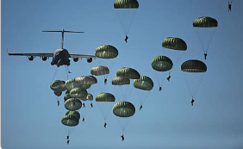
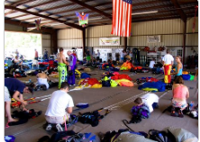
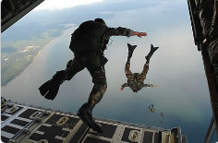
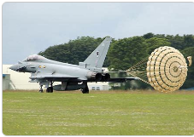
Questions, Comments, Closing remarks

