Slide 1
U.S. ARMY COMBAT CAPABILITIES DEVELOPMENT COMMAND SOLDIER CENTER
ADEST ELECTRONIC SUBMISSION REQUIREMENT FOR CONTRACTORS
22 July 2024
Controlled by:
Controlled by:
CUI Category:
Distribution Statement:
POC:
Tracy Walker, Textile Technologist, Aerial Delivery Engineering Support Team

Slide 2
NEW ELECTRONIC SUBMISSION REQUIREMENT
Below language is now included in ADEST reports and email signature block.
Electronic Submission is required for all documentation related to Inspections
NOTE: ADEST will no longer accept documentation in paper form. All documentation is to be sent electronically with the preferred method being the DoD SAFE link https://safe.apps.mil/
Manufacturers can request a link by emailing tracy.j.walker16.civ@army.mil or barita.a.riley.ctr@army.mil
We will then send the manufacturer the link. Mfg. files can be dropped in the DoD SAFE and retrieved by ADEST. Link remains valid for 14 days.
ALL TMTS, FAT, PLT physical samples must be in the process of shipment when code is requested. We will download the files and await shipment arrival to begin inspection.

Slide 3
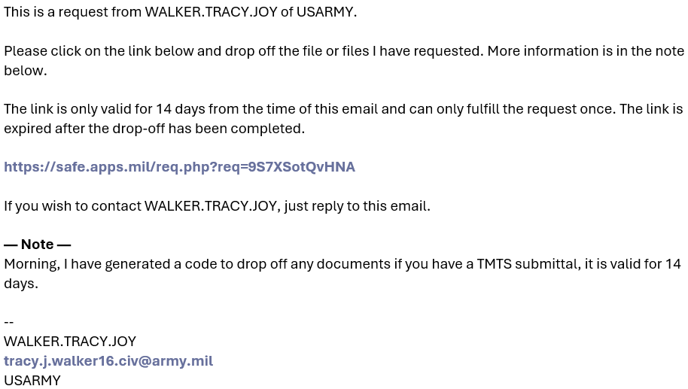
Dropping off files using DOD Safe Link
Manufacturer must email ADEST POC (tracy.j.walker16.civ@army.mil or barita.a.riley.ctr@army.mil) requesting a link to drop off documentation.
Manufacturer will receive the below email with active link valid for 14 days-

Slide 4
Electronic Documentation
SafeLink DOD submission must include the following-
DCMA signed DD1222 (for ALL submittals).
Material Certification documents and testing reports (if TMTS submittal).
Inspection documents (If FAT or PLT submittal).
Note- ALL TMTS, FAT, PLT physical samples must be in the process of shipment when link is requested. We will download the files and await shipment arrival to begin inspection.
Official start date of review begins when all items are received.
Please ensure shipped package is sent to ATTN-Tracy Walker and identifies the Manufacturer name and Contract number. This can be marked directly on the box, by including DD1222 in the box, or simply a written paper identifying what we should log in.

Slide 5
QUESTIONS?
WHEN IN DOUBT, PLEASE REACH OUT-
Tracy Walker
DLA Liaison for ADEST
Textile Technologist
DEVCOM Soldier Center
Aerial Delivery Engineering Support Team (ADEST)
Desk:(508)-206-3217
Cell: (508)-314-7038
Tracy.J.Walker16.civ@army.mil
Barita Riley
Textile Technologist
DEVCOM Soldier Center
Aerial Delivery Engineering Support Team (ADEST)
Phone: 508-206-3183
Barita.A.Riley.ctr@army.mil

